Slide 1
Artificial Neural Networks
اَعُوذُ بِاللہِ مِنَ الشَّیِطٰنِ الرَّجِیمْ
بِسْمِ اللہِ الرَّحَمٰنِ الرَّحِیمْ
Note: Some slides and/or pictures are adapted from Lecture slides / Books of
https://www.coursera.org/specializations/deep-learning
https://d2l.ai/chapter_preface/index.html
https://deeplearning.cs.cmu.edu/S23/index.html

Slide 2
Deep Neural Network

Slide 3
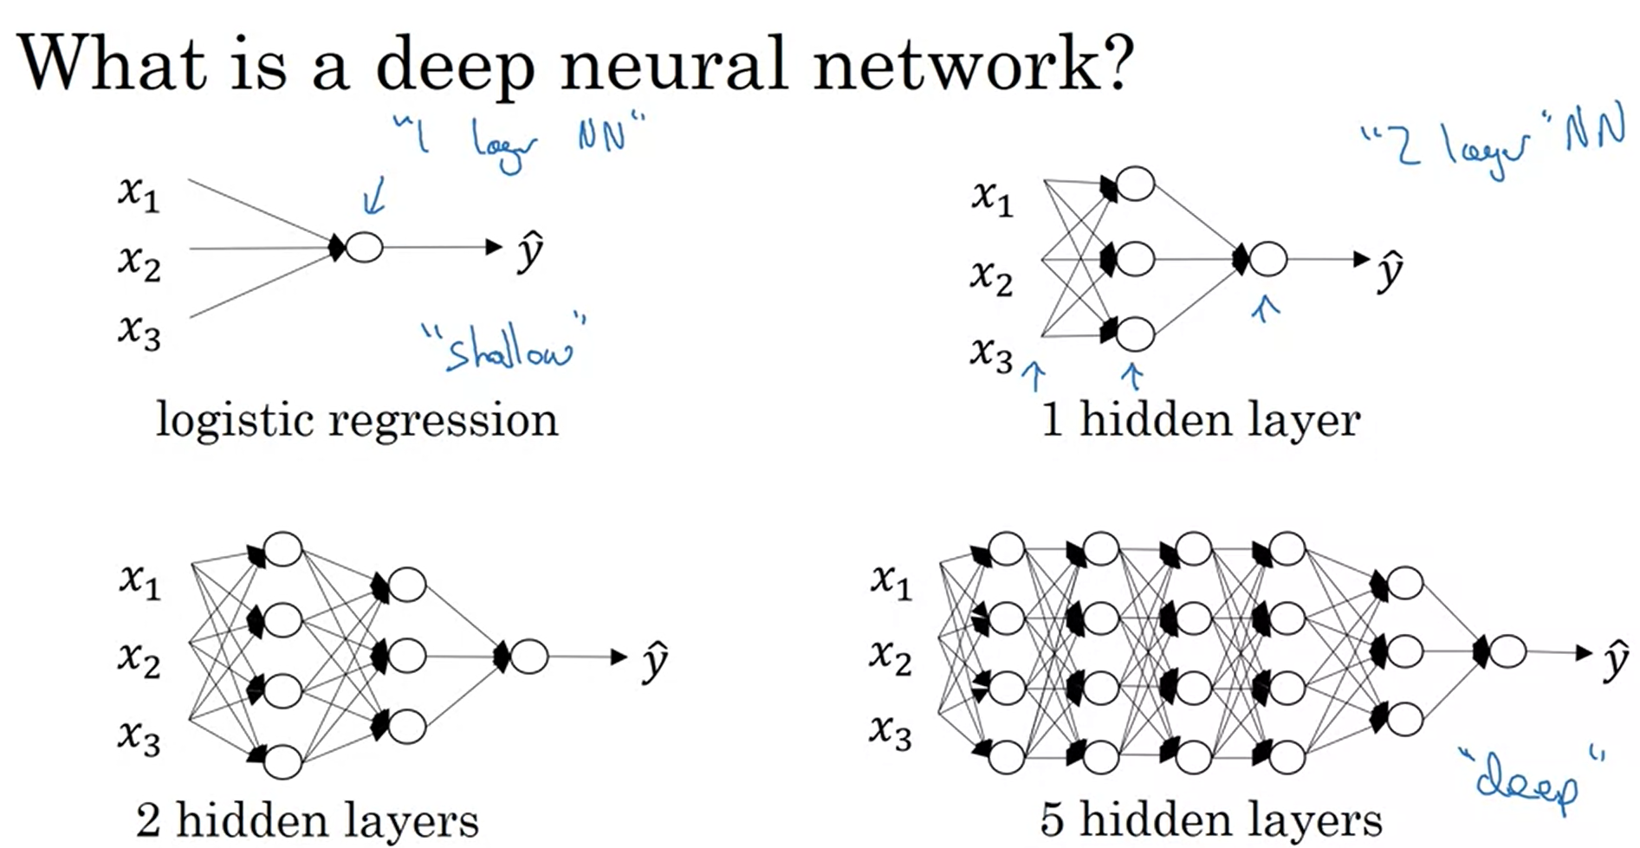

Slide 4
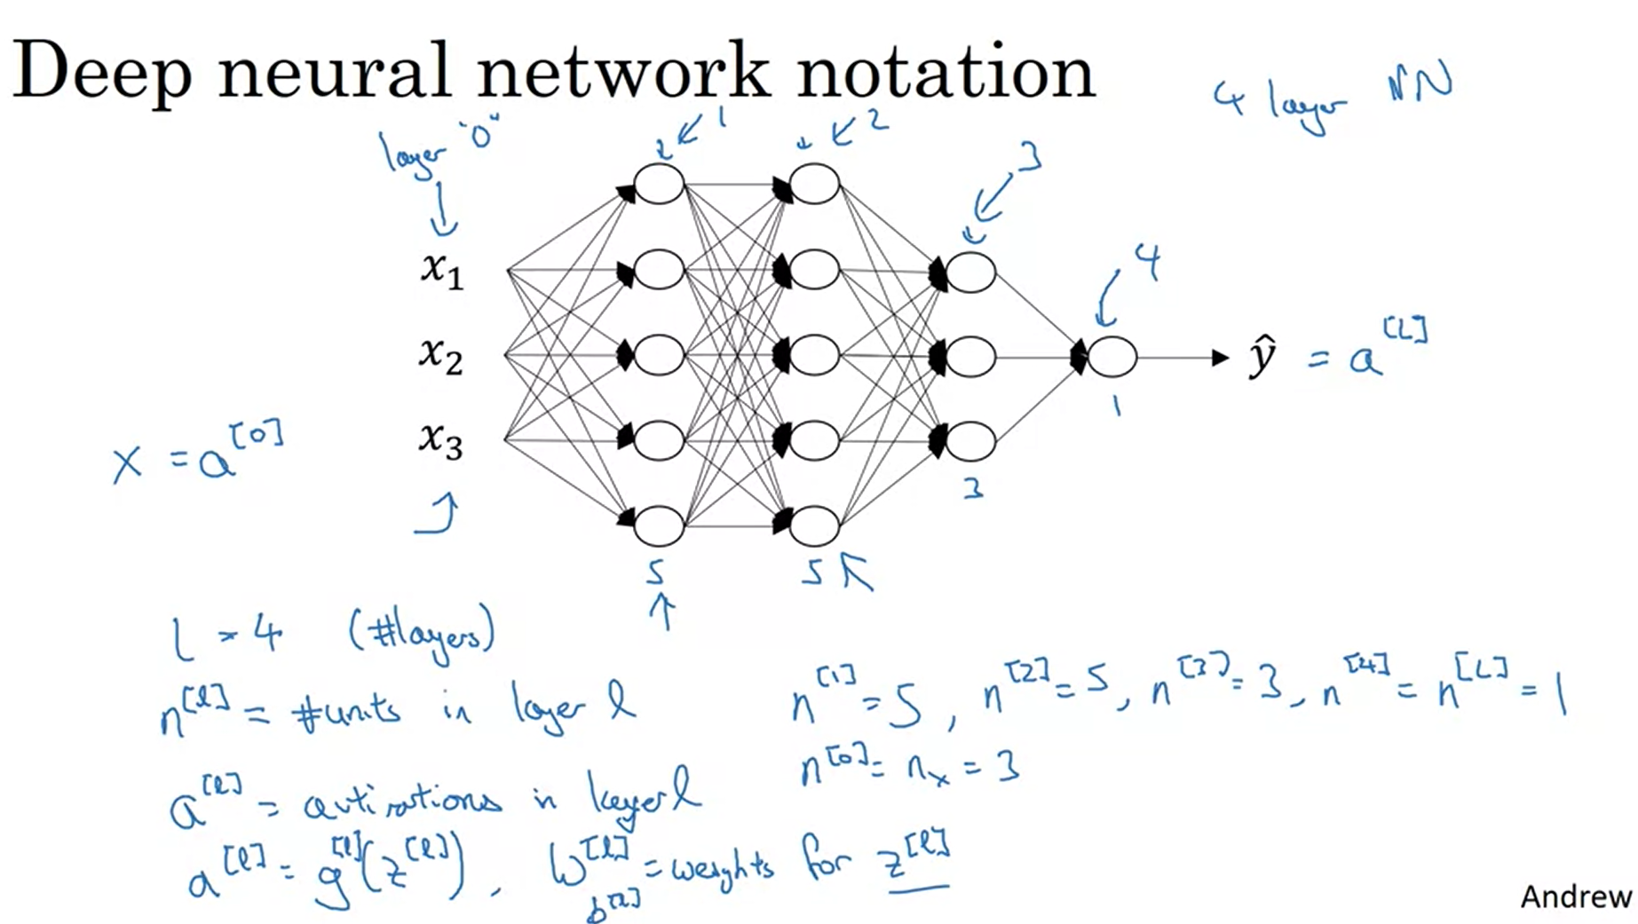

Slide 5
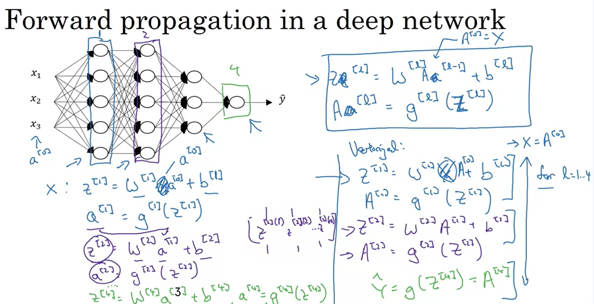

Slide 6
Getting your matrix
dimensions right

Slide 7




Parameters $W^{[l]}$ and $b^{[l]}$
$$x_{1}$$
$$\hat{y}$$
$$x_{2}$$

Slide 8
Vectorized implementation
$$x_{1}$$
$$\hat{y}$$
$$x_{2}$$

Slide 9
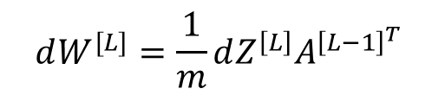



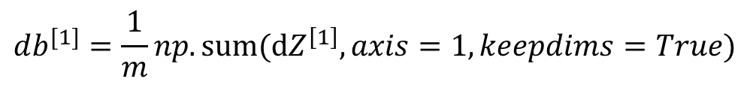


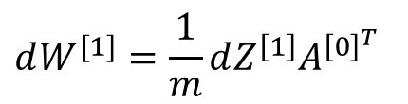



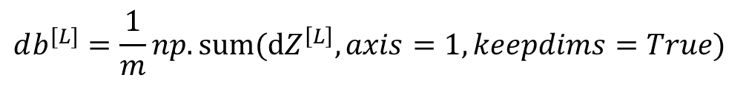
Forward and backward propagation
For example the first activation functions could be ReLU and the last one
Could be sigmoid
$$Z^{[1]}=W^{[1]}X+b^{[1]}$$
$${dZ}^{[L]}=A^{[L]}−Y$$
$$A^{[1]}=g^{\left[1\right]}(Z^{\left[1\right]})$$
$$dW^{[L]}=\frac{1}{m}dZ^{\left[L\right]}A^{{\left[L−1\right]}^{T}}$$
$$Z^{[2]}=W^{[2]}A^{[1]}+b^{[2]}$$
$$db^{[L]}=\frac{1}{m}np. sum(dZ^{\left[L\right]},axis=1, keepdims=True)$$
$$A^{[2]}=g^{\left[2\right]}(Z^{\left[2\right]})$$
…
$${dZ}^{[L−1]}=W^{{\left[L\right]}^{T}}dZ^{\left[L\right]}{∗g^{′}}^{\left[L−1\right]}(Z^{\left[L−1\right]})$$
$$A^{[L]}=g^{\left[L\right]}\left(Z^{\left[L\right]}\right)=\hat{Y}$$
…
$${dZ}^{[1]}=W^{[2]}dZ^{\left[2\right]}{{ ∗ g}^{′}}^{\left[1\right]}(Z^{\left[1\right]})$$
$$dW^{[1]}=\frac{1}{m}dZ^{\left[1\right]}A^{{\left[0\right]}^{T}}$$
$$db^{[1]}=\frac{1}{m}np. sum(dZ^{\left[1\right]},axis=1, keepdims=True)$$
Align left/vertical will mess up the equations here

Slide 10
Why deep
representations?

Slide 11

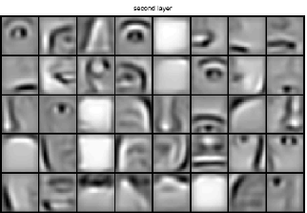
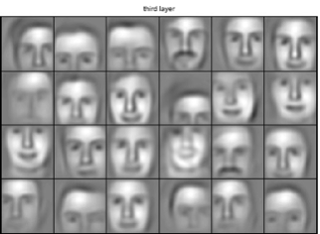

Intuition about deep representation
$$\hat{y}$$

Slide 12
Intuition about deep representation
$$\hat{y}$$

Slide 13
Building blocks of
deep neural networks

Slide 14





Forward and backward functions
$$x_{1}$$
$$x_{2}$$
$$\hat{y}$$
$$x_{3}$$
$$x_{4}$$

Slide 15
Forward and backward functions

Slide 16
Forward and backward
propagation

Slide 17
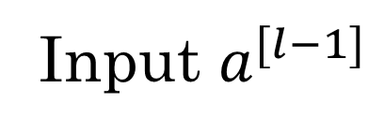
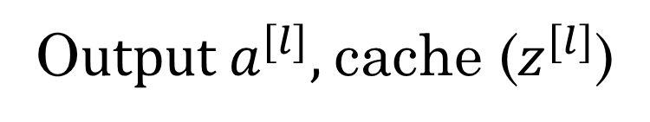
Forward propagation for layer l
Input $a^{[l−1]}$
O$utput a^{[l]},$cache ($z^{[l]}$)
The text that's written should be dw[l]=dz[l]∗a[l−1]Tdw[l]=dz[l]∗a[l−1]T
The "a" should be transposed.
Notes:
the text that's written should be dw[l]=dz[l]∗a[l−1]Tdw[l]=dz[l]∗a[l−1]T
The "a" should be transposed.

Slide 18
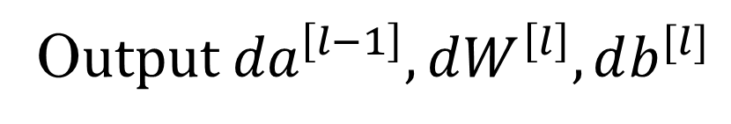
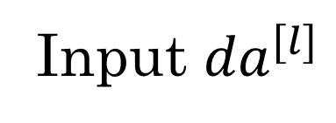
Backward propagation for layer l
Input ${da}^{[l]}$
O$utput {da}^{\left[l−1\right]},dW^{\left[l\right]},db^{[l]}$

Slide 19
Summary

Slide 20
Parameters vs
Hyperparameters

Slide 21
What are hyperparameters?
Parameters: $W^{\left[1\right]} ,{ b}^{\left[1\right] }, W^{\left[2\right]} ,b^{\left[2\right] },W^{\left[3\right] }, b^{\left[3\right] }…$

Slide 22

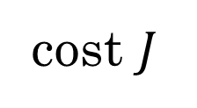
Applied deep learning is a very empirical process
Idea
cost $J$
Experiment
Code
# of iterations

Slide 23
Q & A

